Slide 1
Regime-switching RL model for Portfolio Optimization
-Akash

Slide 2
What is the Problem? Why is it important?
Portfolio optimization aims to allocate capital across assets to balance return and risk. It is a fundamentally difficult problem due to “non-stationarity” of the data. Classical approaches break down in highly volatile and non-stationary markets.
Modern single agent RL algorithms fail to detect volatility changes in time, making them slow to market reactions.
This project studies whether a Regime switching reinforcement learning based portfolio optimization can better adapt to market volatility and provide better returns compared to existing methods.

Slide 3
Limitations of Current Approaches
Classical methods rely on fixed statistical assumptions like stationarity.
Existing models train a single policy agent across all market conditions.
These models struggle during high-volatility events, such as the 2008 and 2020 crashes.
Current research provides limited analysis of metrics other than sharpe ratio like portfolio drawdowns and stability across different market conditions.

Slide 4
Proposed Solution & Contributions
We propose a Hierarchical Mixture-of-Experts architecture.
This approach decouples regime detection from policy execution.
We will train distinct PPO agents explicitly on disjoint market conditions (e.g., high vs. low volatility).
The goal is to better adapt to market volatility and improve returns compared to existing methods.

Slide 5
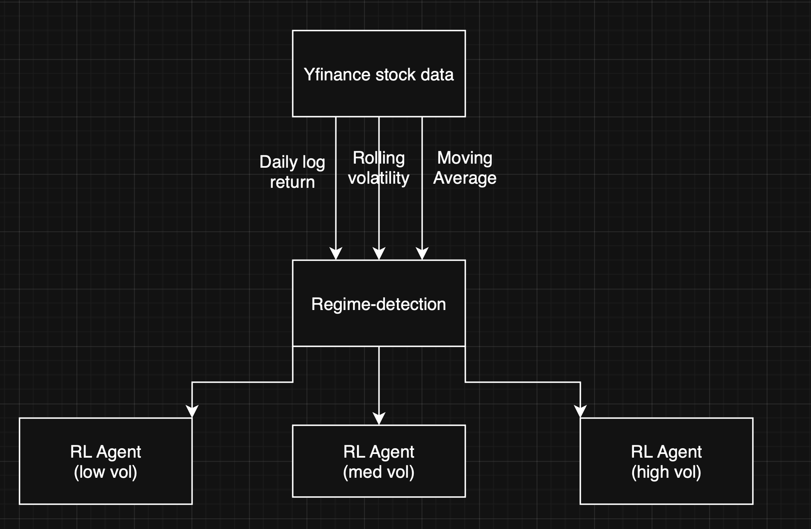
High-Level Architecture
The current pipeline ingests Yfinance stock data to calculate three key features: daily log return, rolling volatility, and moving average. These inputs are fed into the regime-detection module , which evaluates the current market state and routes the execution to one of three specialized RL agents operating in low, medium, or high volatility conditions

Slide 6
Milestone Update: Baseline Implementation
I successfully reproduced a baseline comparing a PPO agent versus Mean-Variance Optimization (MVO).
Data: 11 US sector ETFs from 2006 to 2024.
RL Configuration: PPO agent utilizing a Differential Sharpe Ratio reward.
MVO Configuration: Ledoit-Wolf shrinkage with a max-Sharpe objective.
Metric | DRL | MVO
Sharpe Ratio | 1.17 | 0.68
Annualized Return | 12.11% | 6.53%
Max Drawdown | -32.96% | -33.03%

Slide 7
Baseline Results & Identified Limitations
The Deep Reinforcement Learning (DRL) agent achieved a Sharpe Ratio of 1.17 compared to MVO's 0.68.
DRL Annualized Return was 12.11%, significantly outperforming MVO's 6.53%.
However, both approaches suffered a similar Max Drawdown (approx. -33%).
Limitation Identified: The single-agent strategy lacked regime awareness across varying volatility periods.

Slide 8
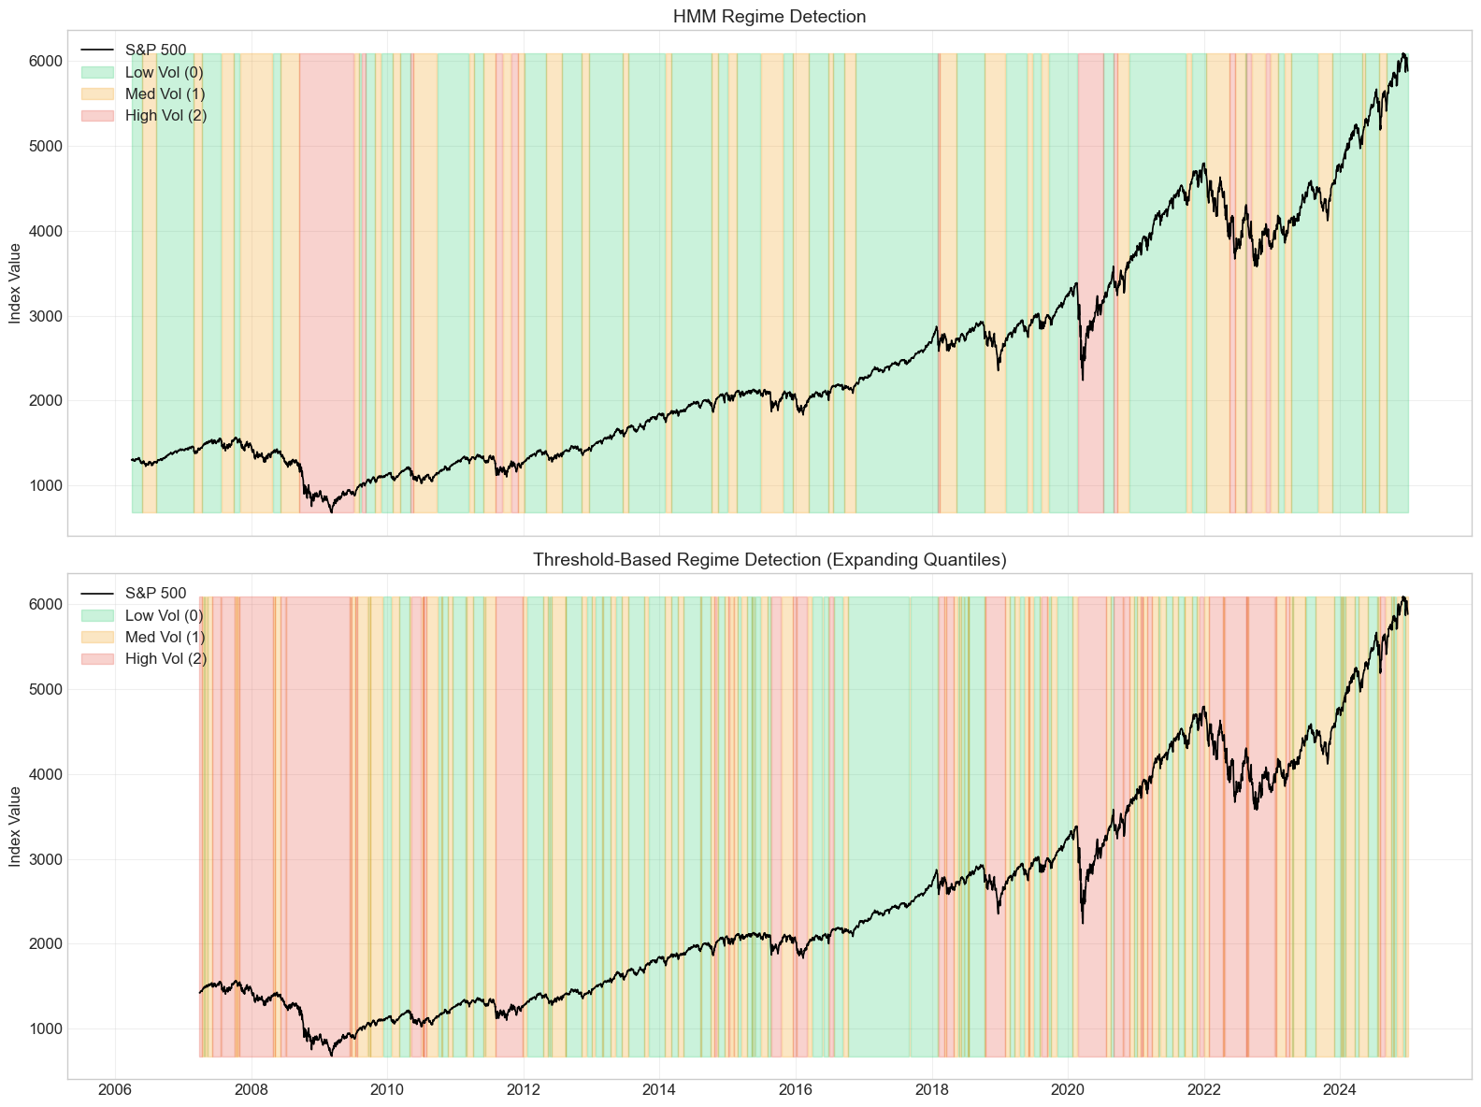
Gaussian HMM Configuration
Model: Gaussian HMM utilizing the Expectation-Maximization (EM) algorithm to maximize log-likelihood.
Features Used: Daily log return, 20-day rolling volatility, and Moving Average ratio (20/60).
Training Data: S&P 500 from 2006–2019 (3,522 days).
Testing Data: S&P 500 from 2020–2024 (1,258 days).
Fig. showing the HMM and threshold based regime detection.
HMM performs far lesser regime-switches.

Slide 9
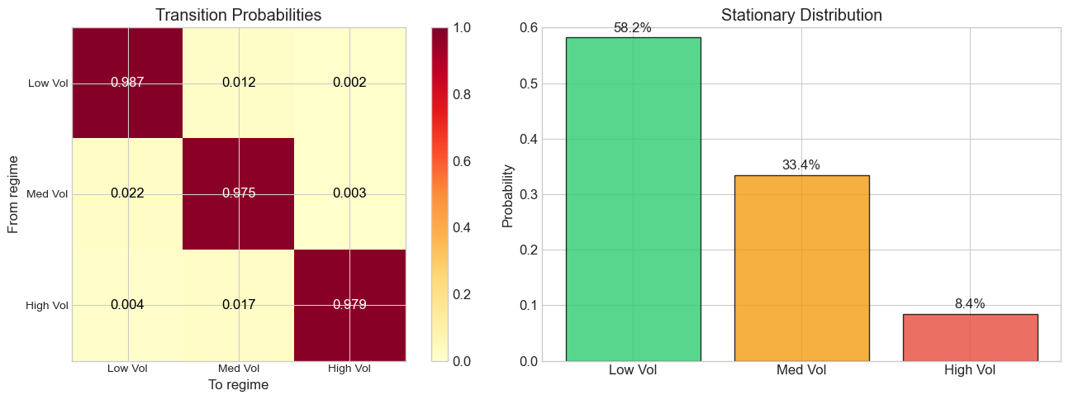
Model Selection: Why 3 Regimes?
We tested models with 2, 3, 4, and 5 regimes.
Adding more regimes increases the risk of overfitting.
A 3-regime structure was determined to be optimal because it yielded the lowest Bayesian Information Criterion (BIC).
Transition matrices reveal that these regimes are "sticky," showing high persistence.
Fig. showing the transition
Matrix of the HMM

Slide 10
Next Phase: RL Agents & Reward Design
Objective: Maximize cumulative return while minimizing risk, turnover, and transaction costs.
Instead of relying solely on the Sharpe ratio, we will implement regime-specific reward functions.
Low-Volatility Regime: Use the Sortino Ratio for asymmetric upside capture.
High-Volatility Regime: Implement Risk Parity to minimize tail-risk.

Slide 11
Evaluation Strategy
Metrics: Cumulative return, Sharpe ratio, and Sortino ratio (to penalize only harmful downside volatility).
Baselines for Comparison: Standard MVO and a Static PPO Agent without regime awareness.
Stress Testing: Evaluate out-of-sample performance during "Black Swan" events, such as the 2008 crash.
We will also analyze the model's switching latency and its implications.

Slide 12
Project Timeline & Roadmap
Late January (Completed): Literature review, dataset selection, and baseline implementation.
February (Completed): Environment setup, RL model definition, and regime detection implementation. (Specifically, finalizing the Gaussian HMM).
March (Current Focus): Training, backtesting, and baseline comparisons. (Currently training the 3 specialized PPO agents and evaluating the regime-switching routing).
April (Upcoming): Final evaluation, report generation, and final presentation.

